Slide 1
Hobby Project
By Pash Sunuwar

Slide 2
Who am I?
How did I approach the specification?

Slide 3

My chosen hobby
Something I do on a daily basis..
Something I find fun

Slide 4


Slide 5
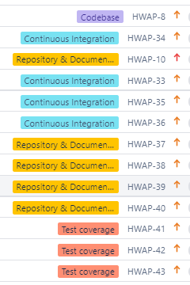
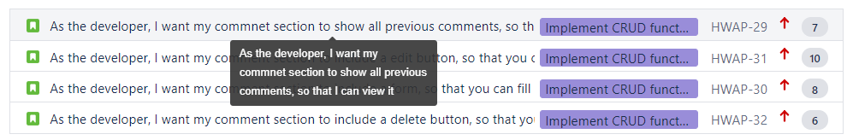
Sprint Plan
Deliverables Checklist (MVP)
https://sunuwarpash.atlassian.net/secure/RapidBoard.jspa?rapidView=6&projectKey=HWAP&view=planning.nodetail&issueLimit=100

Slide 6
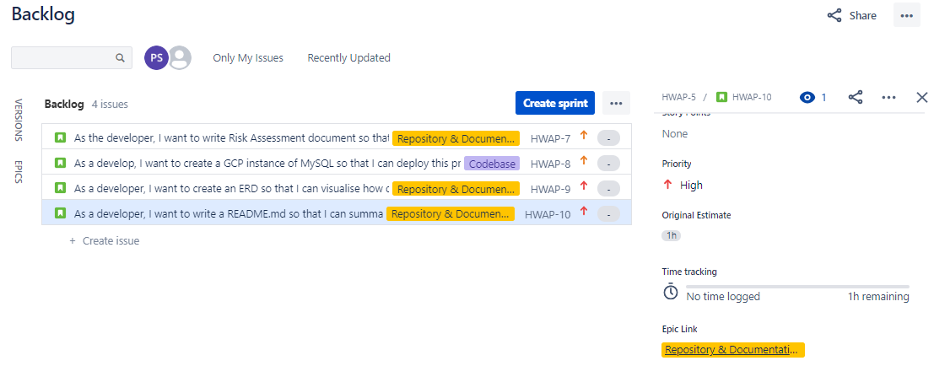
Notes:
Initial backlog- week 1 - risk assessment, gcp instance, erd, readme.md

Slide 7
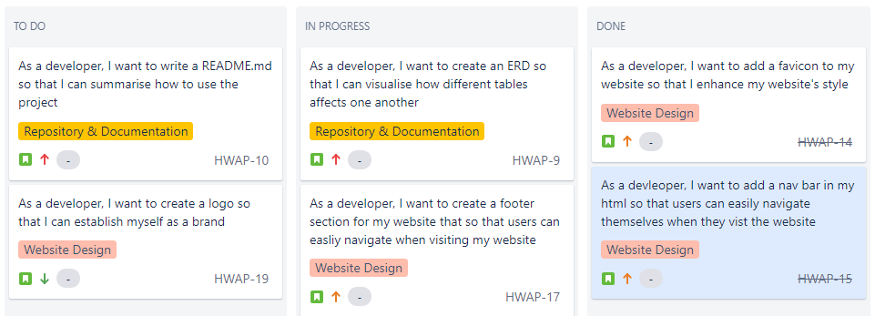
HWAP SPRINT 2 (WEEK 2)
Notes:
Focusing on web design during week 2

Slide 8
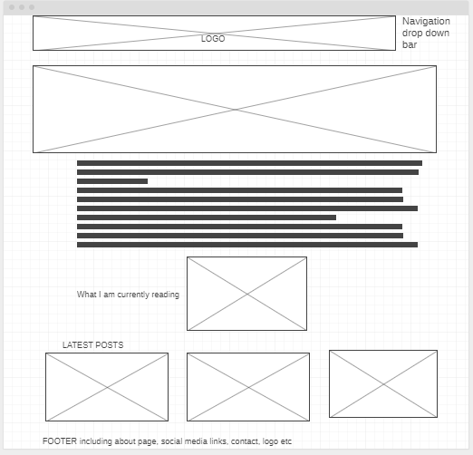
Notes:
Screenshot of my first website template

Slide 9
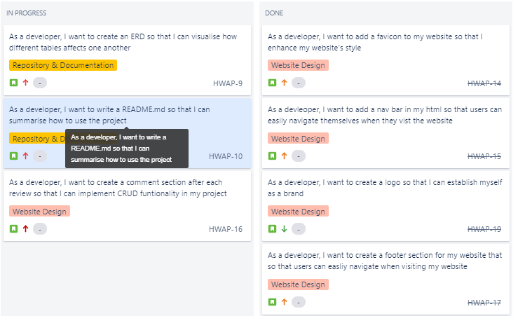

Slide 10
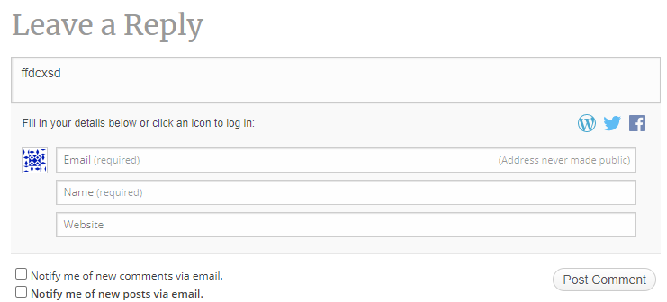
What I am trying to achieve

Slide 11
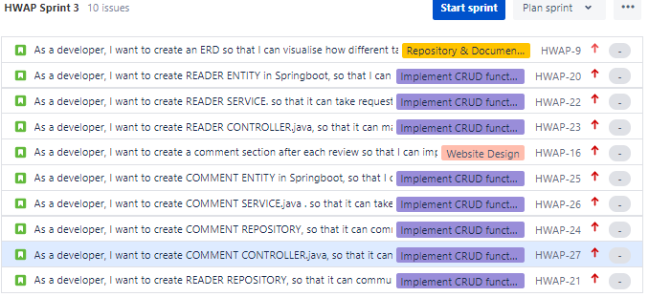
HWAP SPRINT 3 (WEEK 4)

Slide 12
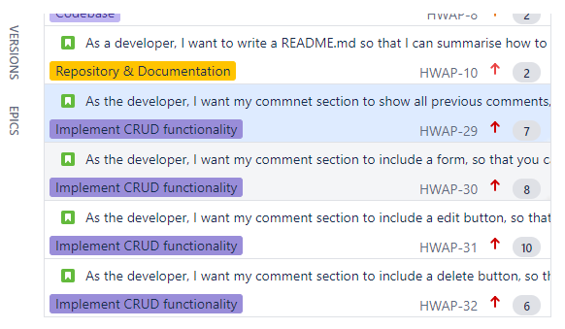
HWAP SPRINT 4 (WEEK 5)

Slide 13
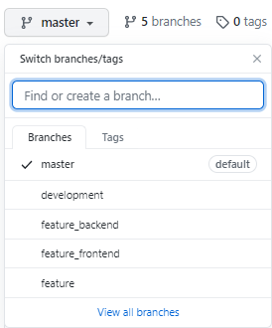
Git setup

Slide 14
Demonstration
:)

Slide 15
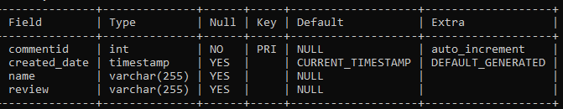
What have I learnt
Coding is fun (when its working)
Springboot
JavaScript
Mocking TIME_STAMP is a pain in *** ****
There must a better method to create a comment section

Slide 16
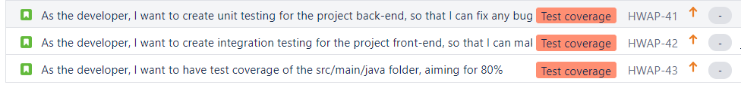
Sprint Review

Slide 17
Sprint retrospective
What went well?
What could be improved?

Slide 18
Conclusion
Reflection on the project
Future steps

Slide 19
Thank you for listening
Any questions

